Slide 1
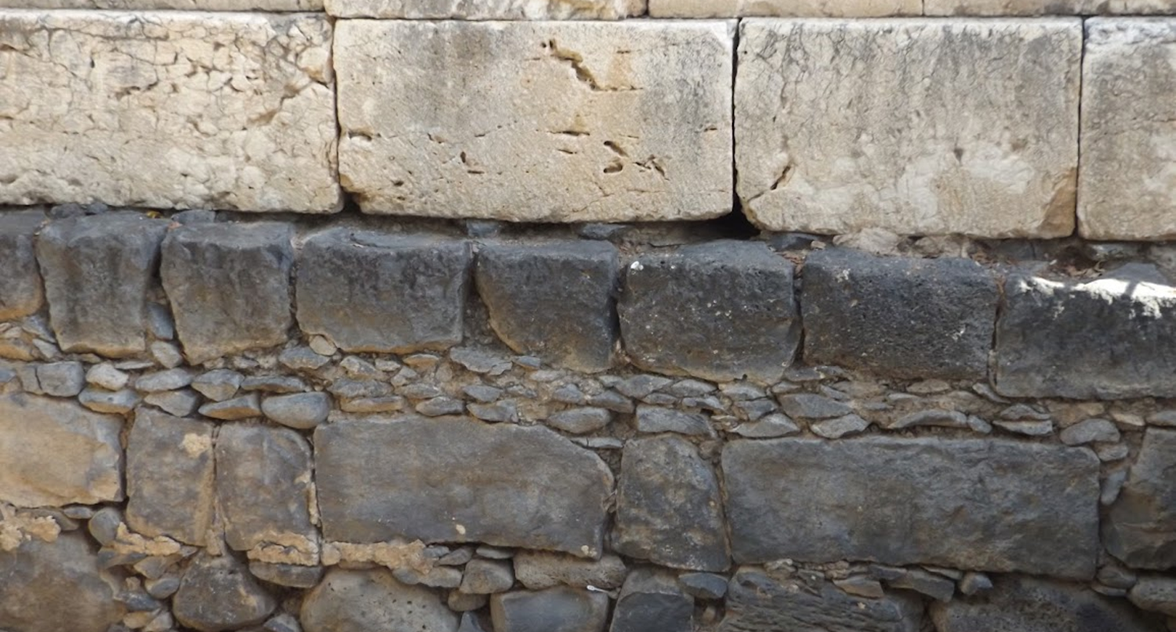

Studies in the Epistles
Foundations  Quarter 17
Lesson 1: First Timothy Introduction & Chapter 1

Slide 2
Outline of 1 Timothy
Chapter One – Timothy is to wage the good warfare.
Chapter Two – Expectations for the public behavior of believers.
Chapter Three – Qualifications of elders and deacons
Chapter Four – Saving others and himself from false teaching.
Chapter Five – Dealing with differences in age, gender, economic status and spirituality.
Chapter Six – Focus on the gain of godliness, not material riches.

Slide 3
Expectations for Public Behavior (1 Timothy 2)
Praying everywhere for everyone (2:1-8).
Pray for all people (2:1-4).
  Supplications, prayers, intercessions, and giving of thanks refer to different aspects of our communication with God.
  Prayer is to be made for all who are in authority,..
    To the end that we can lead quiet and peaceful lives in godliness.
    Because God desires all to be saved and know the truth.
Christ our mediator enables and empowers our prayers (2:5-7).
  Jesus is uniquely suited to be our mediator (Job 9:32-35; Heb. 4:14-16).
  Through Him, we may come boldly into God’s presence (Heb. 10:19-22).
  Paul was appointed to give testimony to Christ’s redeeming work.
Men should “pray everywhere lifting up holy hands, without wrath and doubting” [or “arguing”] (cf. Ps. 24:3-4; Ex. 17:12; Neh. 8:6).
Notes:
Job 9:32-35 "For He is not a man, as I am, That I may answer Him, And that we should go to court together. 33 Nor is there any mediator between us, Who may lay his hand on us both. 34 Let Him take His rod away from me, And do not let dread of Him terrify me. 35 Then I would speak and not fear Him, But it is not so with me.
Hebrews 4:14-16 Seeing then that we have a great High Priest who has passed through the heavens, Jesus the Son of God, let us hold fast our confession. 15 For we do not have a High Priest who cannot sympathize with our weaknesses, but was in all points tempted as we are, yet without sin. 16 Let us therefore come boldly to the throne of grace, that we may obtain mercy and find grace to help in time of need.
Hebrews 10:19-22 Therefore, brethren, having boldness to enter the Holiest by the blood of Jesus, 20 by a new and living way which He consecrated for us, through the veil, that is, His flesh, 21 and having a High Priest over the house of God, 22 let us draw near with a true heart in full assurance of faith, having our hearts sprinkled from an evil conscience and our bodies washed with pure water.
“Lifting up holy hands” – the emphasis is not on the lifting of the hands (which anyone may do), but the holiness of the hands lifted:
We do not hide our hands behind our backs (illus. in readers material)
Psalms 24:3-4 Who may ascend into the hill of the LORD? Or who may stand in His holy place? 4 He who has clean hands and a pure heart, Who has not lifted up his soul to an idol, Nor sworn deceitfully.
Whose hands are being lifted? Lifting them up “without wrath and arguing” suggests and the activity is with a proper attitude toward others – lifting up their hands (cf. Ex. 17:12 Aaron and Hur holding up the hands of Moses).
The phrase “lifting hands” is used literally and metaphorically
Neh. 8:6 And Ezra blessed the LORD, the great God. Then all the people answered, "Amen, Amen!" while lifting up their hands. And they bowed their heads and worshiped the LORD with their faces to the ground.
Ps. 28:2 Hear the voice of my supplications When I cry to You, When I lift up my hands toward Your holy sanctuary.
Ps. 63:4 Thus I will bless You while I live; I will lift up my hands in Your name.
Ps. 119:48 My hands also I will lift up to Your commandments, Which I love, And I will meditate on Your statutes.
Ps. 34:2 Lift up your hands in the sanctuary, And bless the LORD.
Ps.141:2 Let my prayer be set before You as incense, The lifting up of my hands as the evening sacrifice.

Slide 4
Expectations for Public Behavior (1 Timothy 2)
Deportment of godly women (2:9-15).
Women are to adorn themselves in modest apparel (2:9-10).
  Modest attire reflects a sense of shame, honor, propriety, self-control, common sense, and godliness.
  It is not overly showy or attention grabbing (cf. 1 Peter 3:3-4).
  The real adornment is inward godliness and outward good works.
Women are to learn in quietness and submission (2:11-15).
  Women are to learn in quietness with a view to compliance as subordinates.
  Women are not to teach or have authority over a man.
    The reasons for this are that Adam was created first and that Eve was deceived and fell into transgression.
    The redeeming aspects of woman are her role as a mother coupled with a life of faith, love, holiness, and self-control.
Notes:
“Modest” (“respectable apparel”, ESV) is from kosmios (well arranged, seemly, modest, THAYER) – “orderly” and “decorous” (Strong).
“Propriety” (shamefacedness KJV) is from aidos (a sense of shame or honour, modesty, bashfulness, reverence, regard for others, respect. THAYER).
“Moderation” (“sobriety”, KJV, “self-control” ESV) is from sōphrosunē (soundness of mind, self-control, sobriety) THAYER.
1 Peter 3:3-4 Do not let your adornment be merely outward—arranging the hair, wearing gold, or putting on fine apparel— 4 rather let it be the hidden person of the heart, with the incorruptible beauty of a gentle and quiet spirit, which is very precious in the sight of God.
“Silence” or “quiet/quietness” in these verses is from hēsuchia which STRONG defines as “stillness, that is, desistance from bustle or language: - quietness, silence.”

Slide 5
Qualification of Elders & Deacons (1 Timothy 3)
The office of a bishop is a good work to be desired (3:1-7).
“Bishop,” “elder,” and “shepherd” are different descriptions of the same office or role in the church.
A bishop must be…
  Blameless (above reproach ESV)
  The husband of one wife
  Temperate
  Sober-minded (self-controlled)
  Of good behavior (respectable ESV)
  Hospitable
  Able to teach (apt to teach KJV)
  Not given to wine (a drunkard ESV)
  Not violent (no striker KJV)
  Not greedy for money/covetous
  Gentle (patient KJV)
  Not quarrelsome (not a brawler KJV)
  Not One who rules his own house well
  Having his children in submission with all reverence
  Not a novice (recent convert ESV)
  Having a good testimony among those who are outside
Notes:
The duty of elders is to “shepherd” and “oversee” “Shepherd the flock of God which is among you, serving as overseers…”
1 Peter 5:1-2 The elders who are among you I exhort, I who am a fellow elder and a witness of the sufferings of Christ, and also a partaker of the glory that will be revealed: 2 Shepherd the flock of God which is among you, serving as overseers, not by compulsion but willingly, not for dishonest gain but eagerly;
Acts 20:17, 28 17 From Miletus he sent to Ephesus and called for the elders of the church.
Therefore take heed to yourselves and to all the flock, among which the Holy Spirit has made you overseers, to shepherd the church of God which He purchased with His own blood.

Slide 6
Qualification of Elders & Deacons (1 Timothy 3)
Qualities of deacons and their wives (3:8-13).
A deacon must be…
  Reverent
  Not double-tongued
  Not given to much wine
  Not greedy for money
  Holding the mystery of the faith with a pure conscience
  First be tested…found blameless
  The husband of one wife
  Ruling their children and their own houses well
A deacon’s wife must be…
  Reverent
  Not a slanderer
  Temperate
  Faithful in all things.
  “For those who have served well as deacons obtain for themselves a good standing and great boldness in the faith which is in Christ Jesus.”
Notes:
The duty of elders is to “shepherd” and “oversee” “Shepherd the flock of God which is among you, serving as overseers…”
1 Peter 5:1-2 The elders who are among you I exhort, I who am a fellow elder and a witness of the sufferings of Christ, and also a partaker of the glory that will be revealed: 2 Shepherd the flock of God which is among you, serving as overseers, not by compulsion but willingly, not for dishonest gain but eagerly;
Acts 20:17, 28 17 From Miletus he sent to Ephesus and called for the elders of the church.
Therefore take heed to yourselves and to all the flock, among which the Holy Spirit has made you overseers, to shepherd the church of God which He purchased with His own blood.

Slide 7
Paul’s Purpose for Writing (1 Timothy 3)
Paul wants Timothy to know what to do and how to do it (3:14-16).
He is writing so Timothy will know how to conduct himself in the house of God, which is the church – the pillar and ground of truth (cf. Eph. 2:19-22; Isa. 2:2).
  As one who is a steward in God’s house (cf. 1:4), Timothy is to see to it that the house is organized and operating as God desires.
  Paul has thus far in the epistle encouraged Timothy to stand strong against false teachers, told him of important things to be expected men and women in their public lives, and instructed him concerning the appointment of elders and deacons.
The great “mystery of godliness” is the grand story of God’s grace!
  “God was manifested in the flesh, Justified in the Spirit, Seen by angels, Preached among the Gentiles, Believed on in the world, Received up in glory.”
Notes:
Ephesians 2:19-22 Now, therefore, you are no longer strangers and foreigners, but fellow citizens with the saints and members of the household of God, 20 having been built on the foundation of the apostles and prophets, Jesus Christ Himself being the chief cornerstone, 21 in whom the whole building, being fitted together, grows into a holy temple in the Lord, 22 in whom you also are being built together for a dwelling place of God in the Spirit.
Isaiah 2:2 Now it shall come to pass in the latter days That the mountain of the LORD's house Shall be established on the top of the mountains, And shall be exalted above the hills; And all nations shall flow to it.

Slide 8
Important Lessons:
We need to pray for everyone everywhere, especially for those in authority.
Women are to dress in modest apparel and learn in quietness and submission.
Elders and deacons must meet qualifications given by the Holy Spirit.
In the church, the house of God, we each must conduct ourselves according to the rules of the Master of the House.

